Slide 1
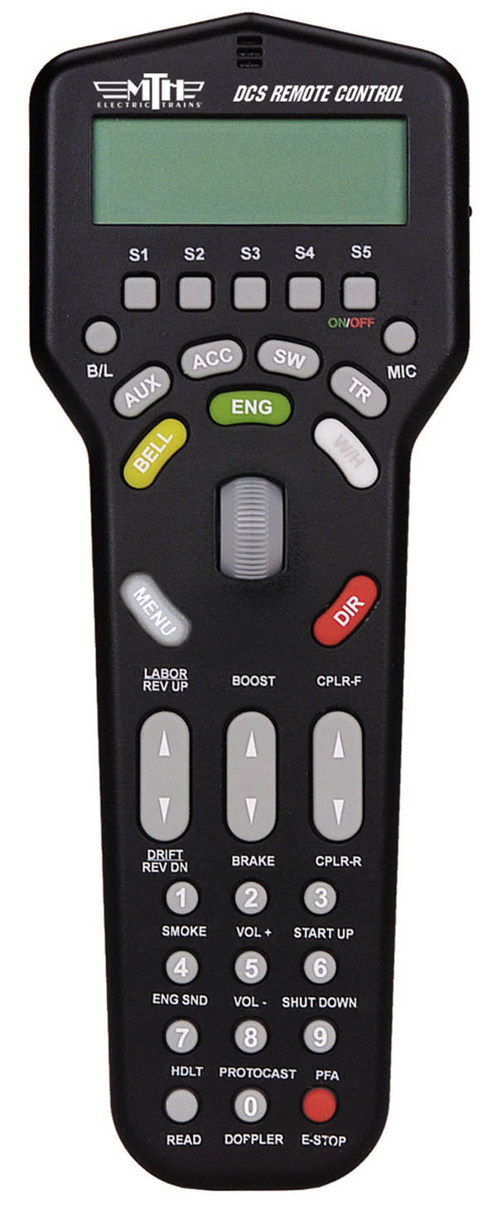
DCS Controller
Turn On
Hold Down
Count to 4

Slide 2
SMPH: 0
4: SP4-8-8-2 #4275
Cab Forward
ENG
4: SP4-8-8-2 #4275
Push

Slide 3
Start Up
Number 3
Shutdown
Number 6

Slide 4
Roll Up to go faster

Slide 5
Roll Down to slow down

Slide 6
STOP and change direction

Slide 7
Whistle
Bell

