Slide 1
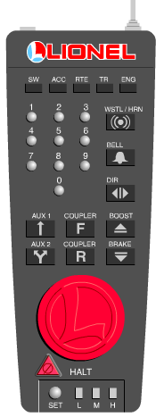
TMCC Controller

Slide 2
Start Amtrak
ENG
3
5

Slide 3
Turn This Way To Go Faster

Slide 4
Turn This Way To Slow Down

Slide 5
STOP and change direction

Slide 6
Whistle
Bell

